Slide 1
WINDOWS 11

Slide 2
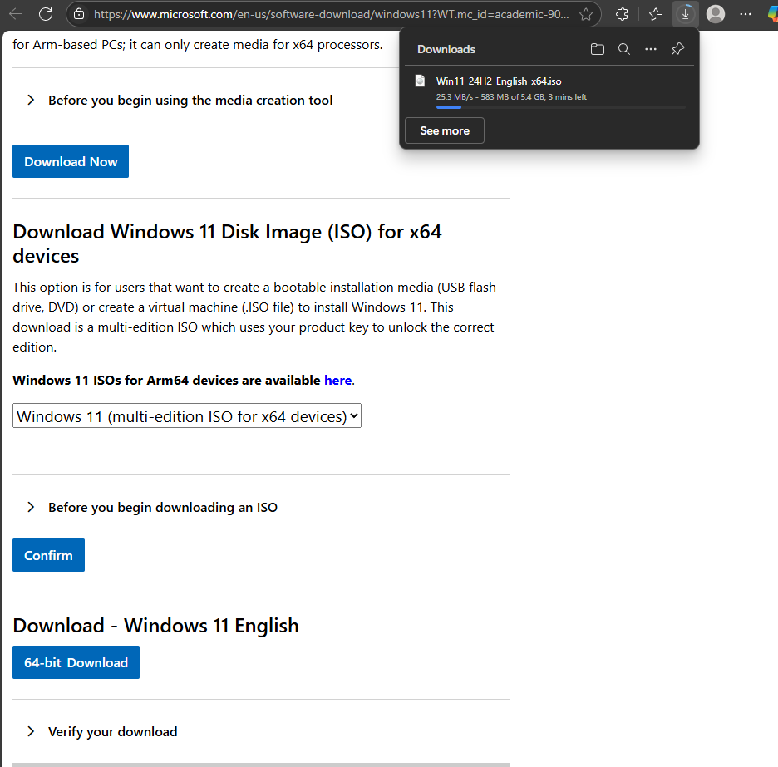
Download ISO

Slide 3
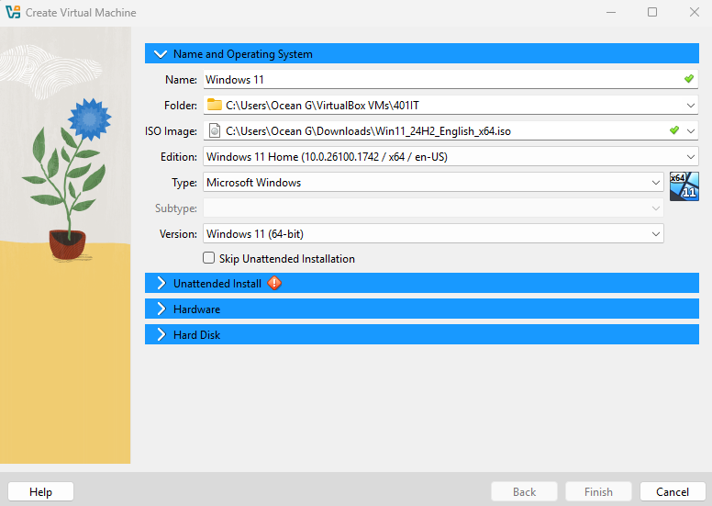
Begin setup for vm creation
Name
Iso
File location

Slide 4
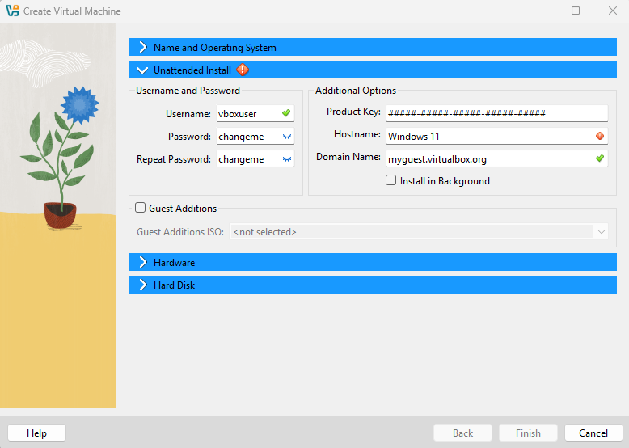
Set password and user

Slide 5
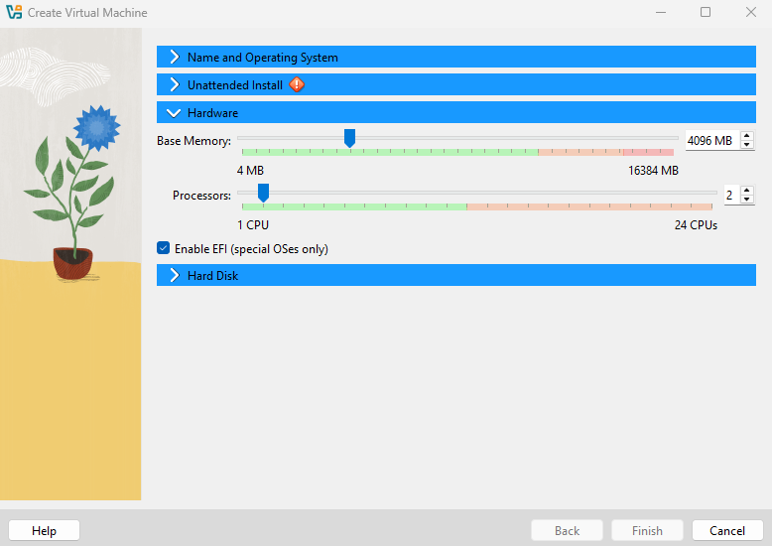
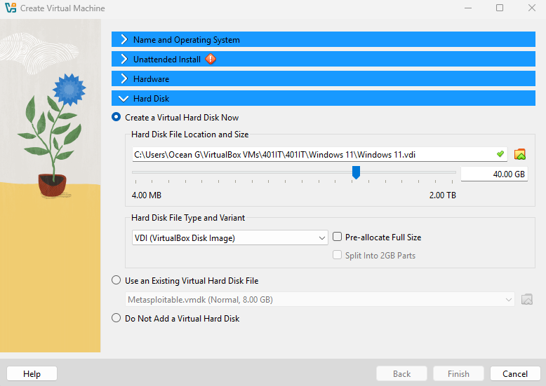
Define resources
Finish creation

Slide 6
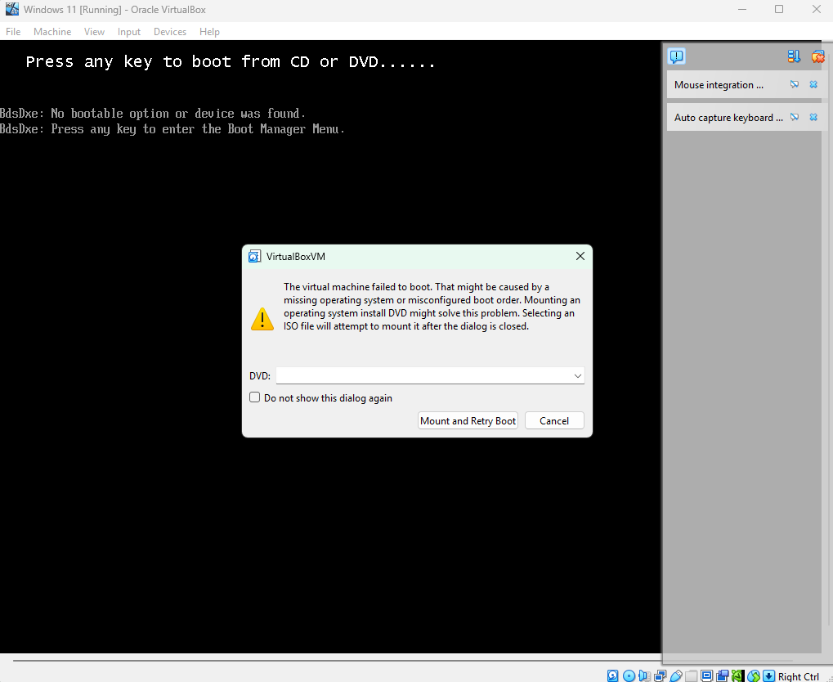
Error
Going into boot
Or using esc during boot.

Slide 7
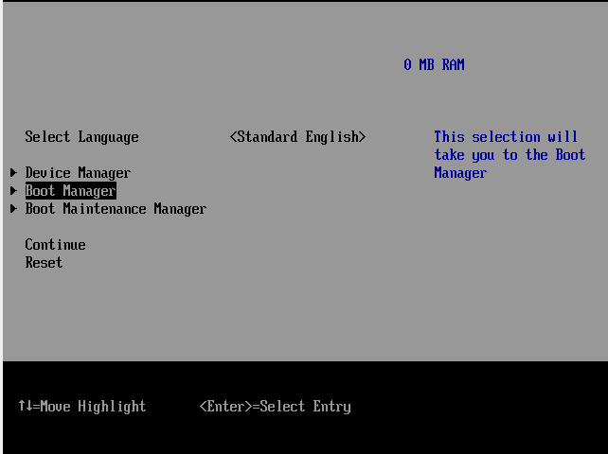
Going into the boot manager and selecting the CD-ROM can get the system to open, however on shutdown of system the issue reappears

Slide 8
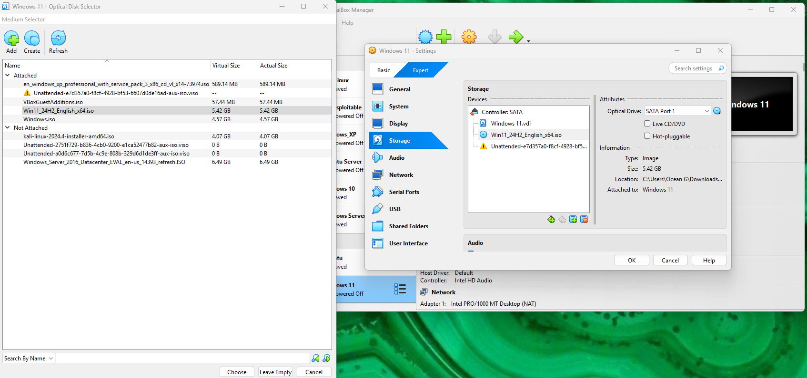
Attempt to attach windows 11 iso to optical drive as well as remove unattended file
unsuccessful

Slide 9
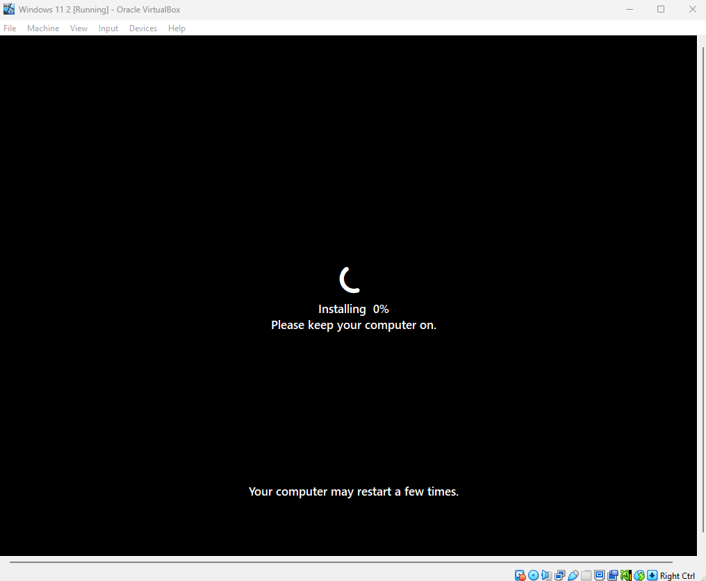
A alternate version of windows 11 was installed witg different settings which resolved the problems of the original
(double the Hard Disk memory)

Slide 10
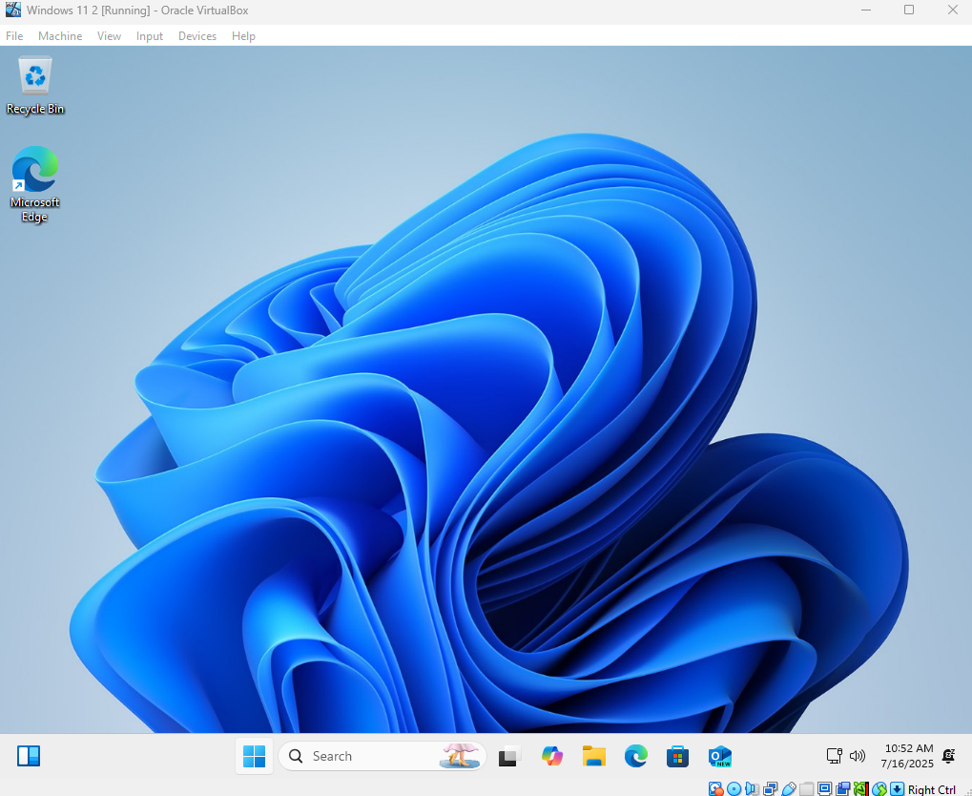
Successful installation

Slide 11
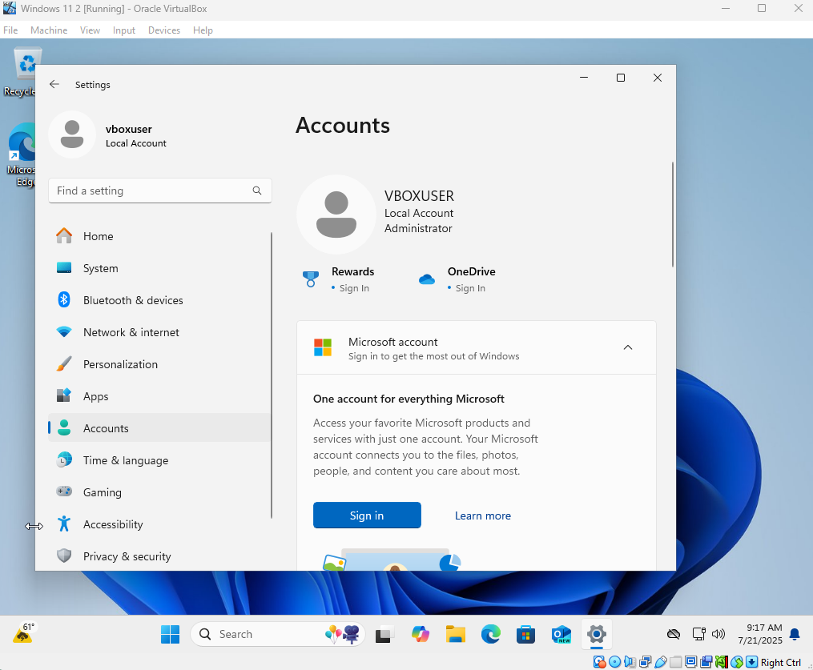
GUI account creation

Slide 12
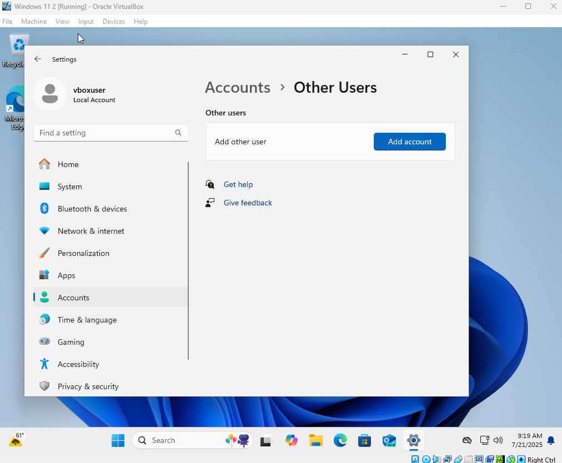

Slide 13
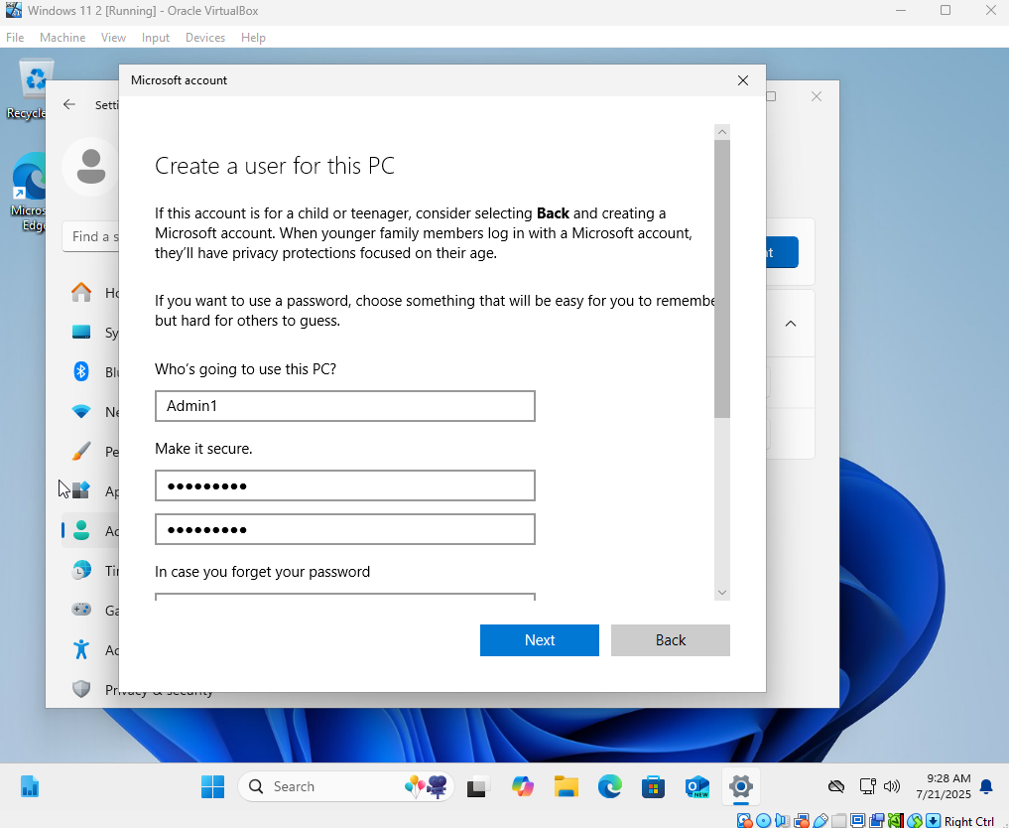
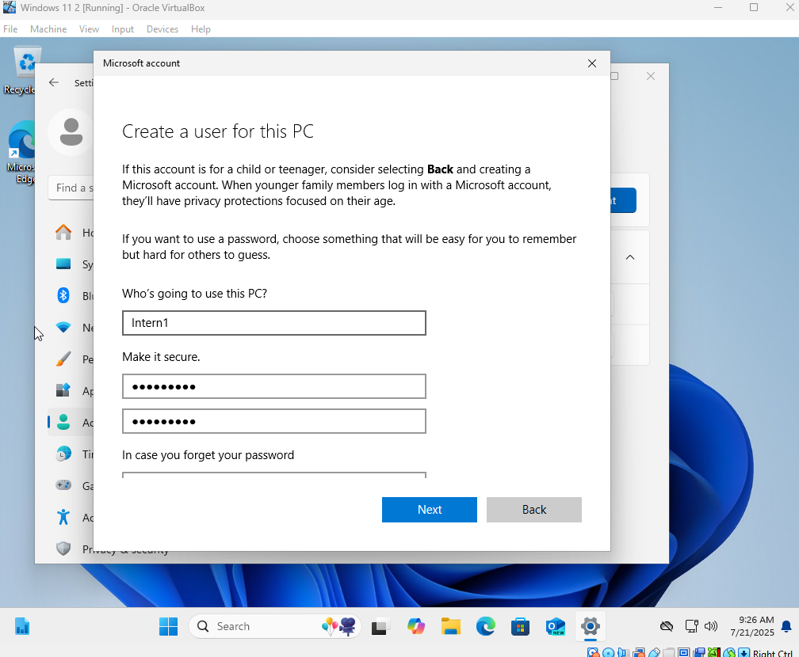

Slide 14
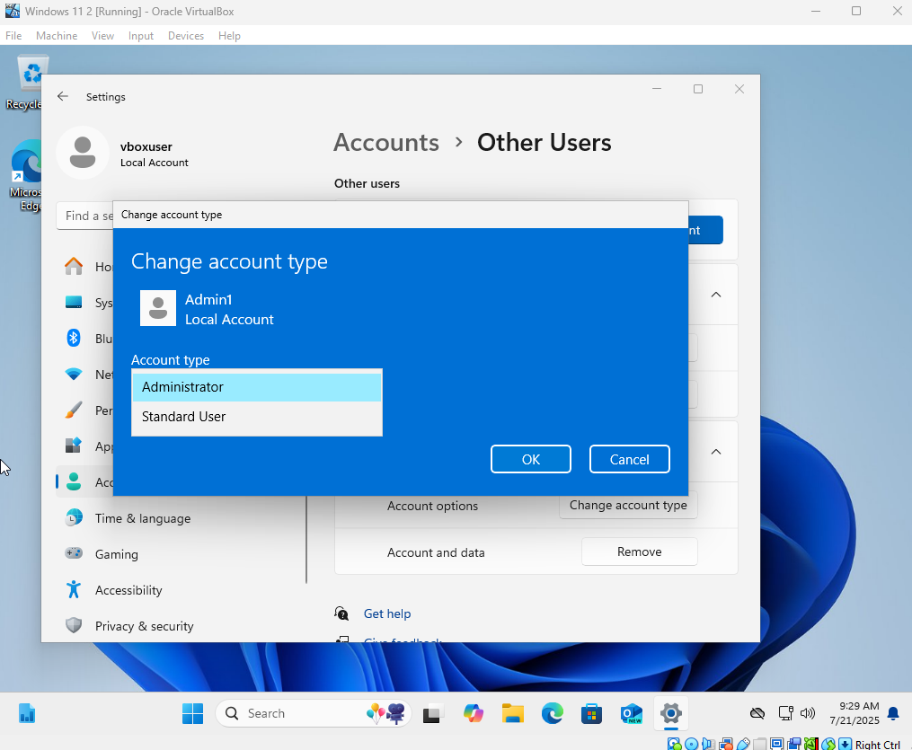

Slide 15


Slide 16
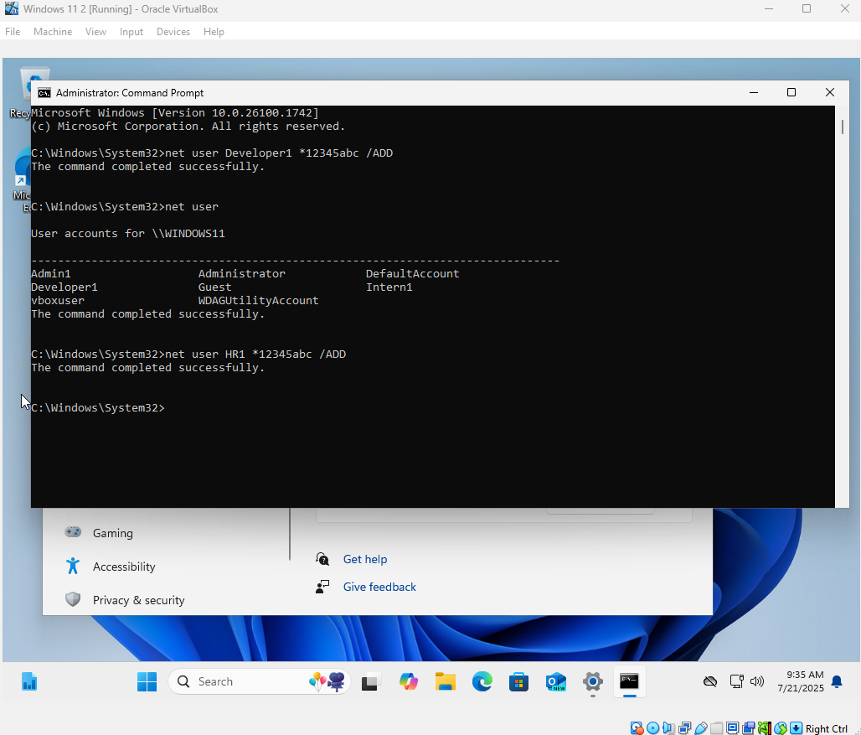
CLI account add

Slide 17
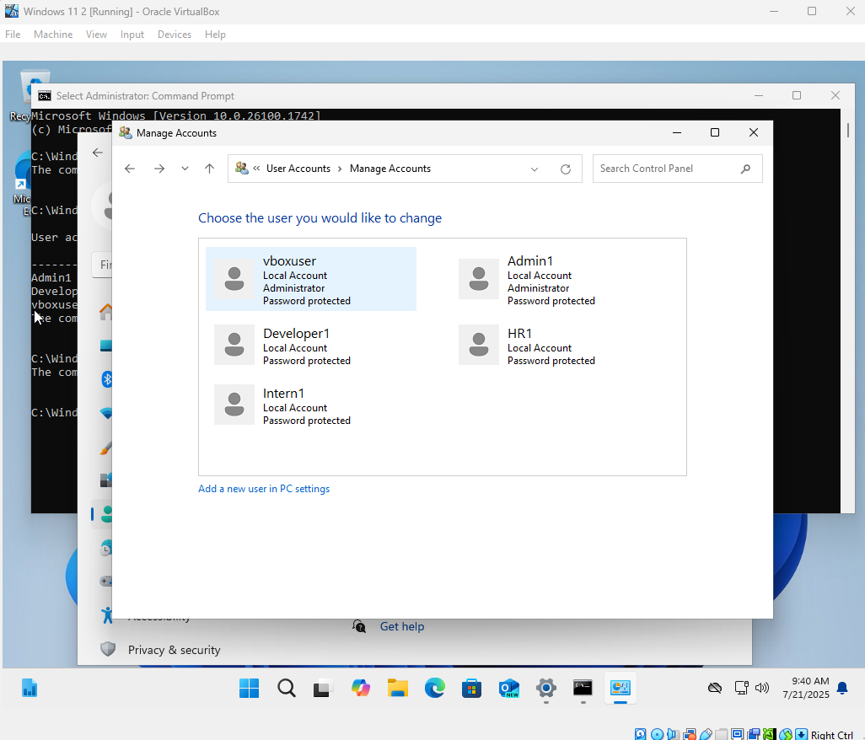
Privilege

Slide 18
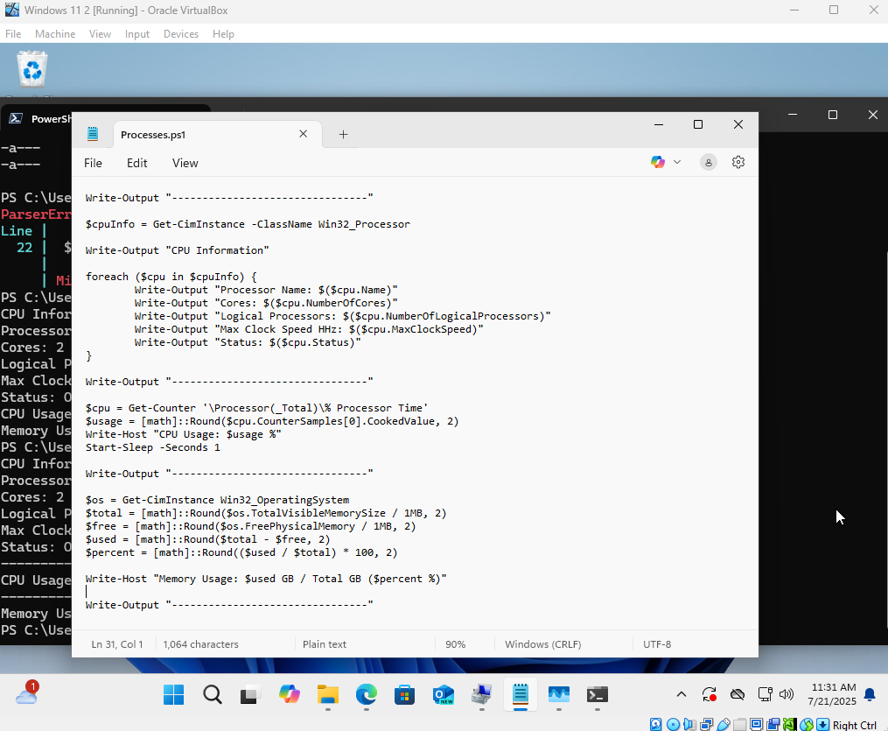
3 sections
Section 1 shows the CPU information with a loop for each detail of the CPU
Section 2 Gets the current CPU usage
Section 3 Gets the current Memory Usage , for easy of understanding, calculates physical memory and ram that is free and in use
all being rounded to 2 D.P

Slide 19
